Slide 1
Webmin

Slide 2
Introduction
Webmin is a web-based interface for system administration for Unix. Using any modern web browser, you can setup user accounts, Apache, DNS, file sharing and much more.
Webmin removes the need to manually edit Unix configuration files like /etc/passwd, and lets you manage a system from the console or remotely.
Webmin is largely based on Perl, running as its own process and web server.
It defaults to TCP port 10000 for communicating, and can be configured to use SSL if OpenSSL is installed with additional required Perl Modules. Webmin removes the need to manually edit Unix configuration files like /etc/passwd, and lets you manage a system from the console or remotely.

Slide 3
Features :-
Web based system configuration tool .
Designed for Unix –like environment .
Open source.
Modular based system .

Slide 4
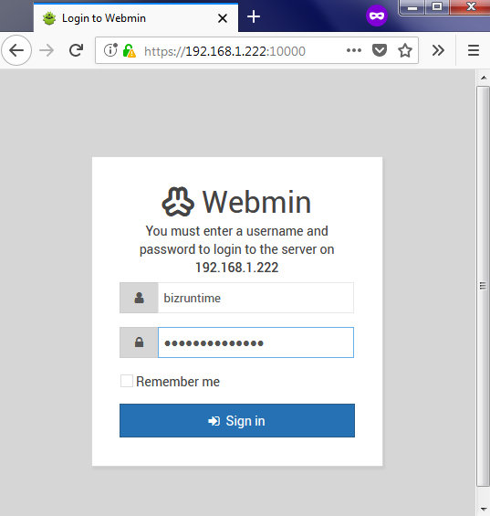

Slide 5
